Slide 1
Axial Piston Pump (Swashplate)
Adonay, Mahmud and Ravi ☺
October 19th 2023

Slide 2
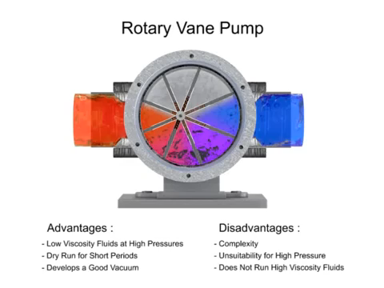
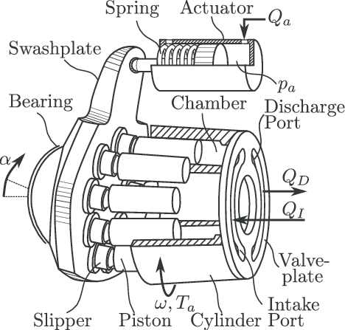
Pump Architecture
Vacuum created in intake port; fluid is sucked in from the tank and discharged in the second part of the rotation.
Swash plate angle controls flow rate.
Shaft turns the barrel. (In special cases the swash plate, e.g. HMT)
Hast, Daniel & Findeisen, Rolf & Streif, Stefan. (2015). Detection and isolation of parametric faults in hydraulic pumps using a set-based approach and quantitative–qualitative fault specifications. Control Engineering Practice. 62. 10.1016/j.conengprac.2015.01.003.
YouTube. (2016). Swash Plate Video. YouTube. Retrieved October 18, 2023, from https://www.youtube.com/watch?v=_VSOgJn-3wo.

Slide 3
Benefits and Limitations
Benefits
Limitations
High efficiency
Compact size
High pressure output
Variable displacement
Smooth operation
Complex design
Sensitivity to contamination
High manufacturing tolerances
Noise and Vibration
Limited suction capability
Temperature sensitivity

Slide 4

Applications
Construction Machinery: Excavators, loaders, cranes
Agricultural Machinery: Tractors, harvesters, sprayers
Industrial Machinery: Presses, injection molding machines
Marine and Offshore Equipment: Ships, offshore platforms
Mining Equipment: Excavators, drills, haul trucks
Material Handling Equipment: Forklifts, conveyor systems
Hydraulic Pump Applications. June 2023. UMBC. https://wiki.umbc.edu/display/faq/Hydraulic+Pump+Application.

Slide 5
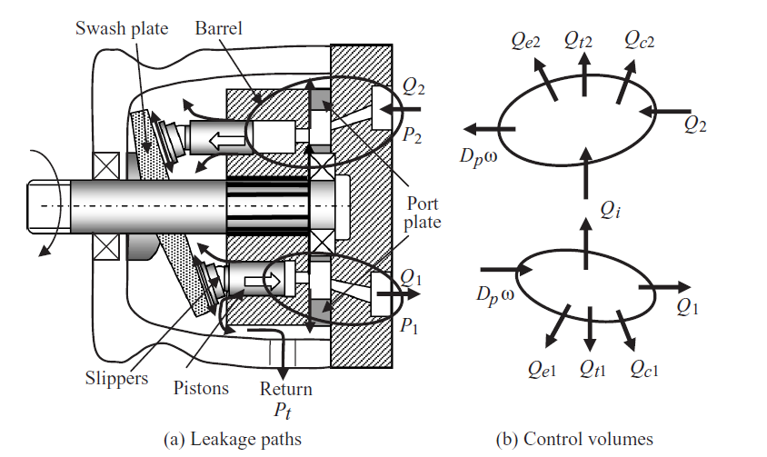
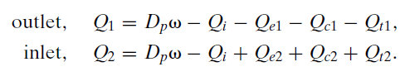

Sources of Energy Losses
Fluid and Mechanical Losses
Flow losses
Cross-port leakage $Q_{i}$
Across components and casing$Q_{e}$
Fluid compression $Q_{c}$
Timing groove losses $Q_{t}$
Viscous Friction
Bearing Friction – Hydrostatic, Shaft ball bearing
Depends on speed, pressure, clearance, seal types, fluid, so on…

Slide 6
Thank You
Have a great rest of your day

Slide 7


